Slide 1

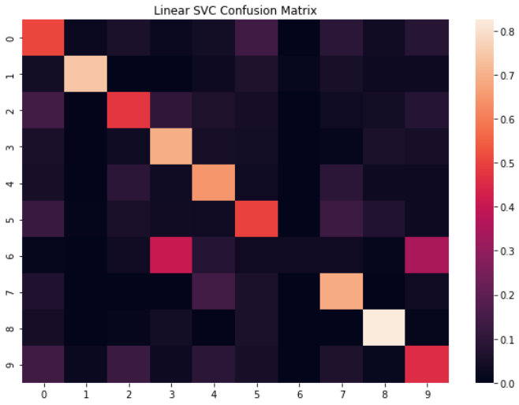
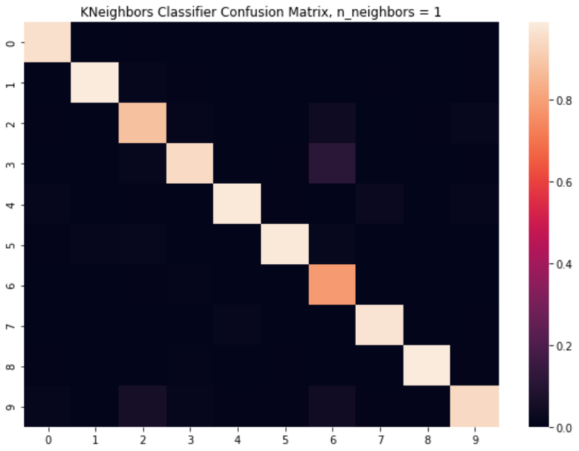
Design and Implementation of Audio Recognition ML Algorithms
Tim Saxon, Kyle Christie
Application of Machine Learning in Mechatronic Systems, Simon Fraser University
Introduction
Machine learning (ML) has applications in audio recognition. This project explores the efficacy of multiple ML algorithms on an urban sound dataset.
Results
Conclusions
Our original expectations were that neural networks would provide the most accurate results. Not only did they fall behind KNeighbors classification in accuracy, but they also took longer by orders of magnitude.
Worst performing model:
Test accuracy: 57.29%
Time to train and test: 17.68s
Classifier: LinearSVC
Slow, inaccurate
Materials and Methods
Algorithms were implemented using python’s Scikit-learn and Keras. These resources provided the ML algorithms. Librosa provided an avenue for audio feature extraction. Numerous ML models were then formed and tested on the extracted data, and their performance was compared
Literature cited
N. Laskaris, Nov. 2019. How to apply machine learning and deep learning methods to audio analysis, Towards Data Science. [Online].
Best performing model:
Test accuracy: 94.39%
Time to train and test: 2.21s
Classifier: KNeighbors
Fast, high accuracy
Acknowledgments
Special thanks to Dr. Mohammad Narimani for the opportunity to work on this project.
Further information
Please see https://towardsdatascience.com/how-to-apply-machine-learning-and-deep-learning-methods-to-audio-analysis-615e286fcbbc
Notes:
INTRODUCTION
- ML is a burgeoning subject in the fields of engineering and computer science, with many applications in data recognition and classification
- One growing usage of ML algorithms is in audio analysis
- The most common examples of audio analysis include virtual assistants such as Amazon’s Alexa, Siri on Apple devices, Google Assistant and Cortana on Microsoft devices
- While these are examples of specifically speech recognition, other non-voice related audio recognition examples exist, like Shazam and Soundhound,
two smartphone apps that use ML to identify songs and tell you the artist and title
- This project involved the design and implementation of a variety of ML models to identify audio samples from an online databank called UrbanSound8K
- As the name suggests, the dataset is made up of over 8000 different recordings of common sounds that can be found in an urban city environment
- The dataset contains 10 different classes altogether: dog barks, car horns, music, sirens, jackhammers, children playing, air conditioners,
gun shots, idling car engines and lastly, drilling
- This project was based on an online article which explained how to extract the necessary features for audio recognition, and used a NN to classify the recording samples
- To build off that, we selected other multi-class classifiers to use, including NN, Support Vector Machines, Decision Trees and KNN so that we could study the accuracy, speed, and overall performance of every algorithm on classifying
the urban sound dataset, and compare the efficiency and effectiveness of every model to each other
Materials
- The machine learning algorithms used were implemented using publicly available machine learning libraries known as Scikit-Learn and Keras
- The feature extraction process relied heavily on Librosa, which is also a public library tailored to audio analysis
- With the human ear, there is a disconnect between the actual frequency of audible noise and our perception of its frequency
- Essentially, we are better at noticing changes in frequency at low frequencies than we are at hearing differences between high frequency signals
- Librosa allowed us to extract the Mel Frequency Cepstrum Coefficients, or MFCCs, of every sample, which characterize an audio file based on the power spectrum of its perceived frequencies.
This takes into account the difference in human frequency recognition across the audible frequency spectrum.
- Using these tools and principles, a variety of different models were trained and tested, showing results with varying levels of acceptability
- The particular models used were: Feed forward NNs with different amounts of hidden layers and nodes; multi-layer perceptron NNs which use backpropagation; several kinds of support vector
machines; decision trees, and lastly several K neighbours classifiers with different K values
Results / Conclusion
Bad
- The worst results we saw from any of our models came from the Linear Support Vector Classifier.
- Giving a test accuracy around 57%, 43 out of 100 of the model’s predictions would be incorrect.
- This model especially struggled to identify the 6th class, being recordings of air conditioners, as can be seen in the confusion matrix
- Training and testing this model took around 18 seconds
Good
- The best results we saw genuinely surprised us, as we initially expected them to come from highly trained Neural Networks
- Using the KNeighbors classifier, we saw a remarkable test accuracy of over 94%, and in only an eighth of the train and test time at just over 2 seconds.
- For every 100 predictions this model makes, only around 6 are inaccurate. (7 times less errors than worst model)
Other models
- The neural network models that we expected to outperform our other models did produce good results, generally achieving test accuracies around 90%.
- Where they really failed, however, was in the time it took to train and test the models, taking 15-30 seconds for less trained models, and more “deeply” trained models taking over 5 minutes
Conclusion
- All of the ML models used managed relatively good results, with high accuracy and reasonable run times.
- The stand out for accuracy was KNN, which managed almost 95% test accuracy
- The stand out for speed was decision trees (0.04s), although they had among the lowest test accuracies at around 70%
- Both sequential feed forward NNs and multi-layer perceptron NNs achieved high accuracy, but had much longer run times, taking in the range of minutes while other models took in the range of seconds
- SVMs in general had good accuracy and speed, but also had the single worst performing model with only 57% test accuracy
- Overall, the best performing model was K neighbours, which had the highest accuracy coupled with fantastic speed
- Regardless of whether the user goal is to achieve high accuracy or high speed, K neighbours was the algorithm to select for this dataset, because it excelled in both categories
- The results of this project are clear on the effectiveness of ML algorithms for audio analysis: in general, most models perform well , and the selection of an algorithm does not have a massive effect on
this dataset in particular, despite there being clearly superior and inferior models
- What remains to be seen is the performance of these same models on other audio samples, to see if there truly is a best algorithm for audio recognition regardless of what data it’s applied to
‹#›

